Slide 1
(SIP) ASBU BO-FICE - AIDC Implementation Seminar (Bangkok, Thailand, 28- 31 October 2014) PROGRESS IN THE MID REGION
Raza Gulam
Regional Officer, CNS
ICAO MID Regional Office, Cairo
ASBU B0 FICE AIDC Seminar 28- 31 October 2014

Slide 2
CONTENTS
Individual initiatives
ATN/IPS WG
WP 38th Assembly
AIDC Seminar
AIDC/OLDI Implementation Strategy
Examples
Implementation level

Slide 3
Initiatives
No specific directives
What to implement
Systems readiness
Coordination issues
Installation not followed

Slide 4
ATN/IPS WG
Analysis Majority of States in the MID Region implemented OLDI, or planning OLDI, no intention of using only AIDC.
Agreed that OLDI implementation should be considered and accepted as Regional variation of AIDC implementation
Both AIDC and OLDI are implemented, it will be a bilateral issue and some States that are interfacing with adjacent Regions may require to support and implement dual capabilities (AIDC and OLDI).
Notes:
Based on the analysis carried out during the MID region ATN-IPS WG5 meeting it was
noted that the majority of States in the MID Region have either implemented OLDI or are planning to
implement OLDI and have no intention of using only AIDC. Therefore, the meeting agreed that OLDI
implementation should be considered and accepted as Regional variation of AIDC implementation as was
the case in the European Region

Slide 5
WP – 38th ASSEMBLY
Montréal, 24 September—4 October 2013
Assembly 38 WP-266: CONCLUSION
The implementation of OLDI in the MID Region should be accepted as a variation AIDC implementation. Wherever both AIDC and OLDI are implemented then States should choose the suitable one satisfying the requirements of the partnering State.
Notes:
UAE
AI 33 AIR NAVIGATION
STANDARDIZATION
OLID AS AIDC REALIZATION IN THE MID REGION

Slide 6
AIDC SEMINAR
ASBU PRIORITY
MID AN STRATEGY
SEMINAR TO SUPPORT IMPLEMENTATION
APAC – EURO PARTICIPATION
AIDC/OLDI IMPLEMENTATION STRATEGY

Slide 7
Seminar Outcome
Identified six (6) MID States that should support both (AIDC/OLDI);
developed an updated AIDC/OLDI Implementation Plan and system capabilities;
agreed on a minimum AIDC/OLDI set of Messages for implementation in the MID Region;
agreed on necessary consideration for the amendment of LoA Template;
developed High level Implementation Check list;
agreed that State should have AIDC/OLDI Focal points;
agreed that APAC and EUR Regional Offices support interregional implementation ; and
agreed on the following list of Recommendations

Slide 8
Seminar Recommendation
States to share experience on AIDC/OLDI implementation including sharing of training and implementation packages and visits to other states;
in order to expedite implementation States are encouraged to engage in test and trials even before signing the Official LoA;
encourage bilateral AIDC/OLDI Workshops;
States to identify operational requirements/Scope and improvements (know what are the messages which are needed/supported by other ATSU) and develop LoA accordingly;
engage both technical and operational experts (CNS/ATM) in the update/amendment of the LoA;

Slide 9
Cont. Seminar Recommendations
States (ATSU) having OLDI/AIDC capability to start implementation activities and plan implementation in Q2 2015;
CNS and ATM Sub Groups to compile the MID AIDC/OLDI Implementation Strategy document to include all references, details of messages; test activities etc.;
States to provide updates (progress reports) on AIDC/OLDI implementation by 15 August 2014;
ICAO MID Regional Office to create a web page depositary for posting AIDC/OLDI Information etc.; and
conduct of a follow-up Seminar in Q4 2015.

Slide 10
AIDC/OLDI IMPLEMENTATION STRATEGY
1. Introduction
2. Background and ASBU BO-FICE
3. ICAO General Assembly 38 WP-266:
4. MID States Current status and detailed Plans
5. Message Types – Phase 1
6. Define Message Types – Phase 2
7. Test objectives
8. Sample Test Scripts
9. Bilateral Agreement Template
10. Implementation Plan

Slide 11
Details on ATM systems to support implementation
State | Focal point contact for AIDC/ OLDI | ATM System | Protocol and Version used | Number of adjacent ATSUs | No of adjacent ATSUs connected by AIDC/OLDI & type of connection | ATM System Capability |  | Current use |  | Planned Use |  | Intention of using AIDC only | Reasons and Remarks
 |  |  |  |  |  | AIDC | OLDI | AIDC | OLDI | AIDC | OLDI
Bahrain | Mr. Mohamed Ali Saleh masaleh@caa.gov.bh | Thales TopSky-C | OLDI 2.3 FMTP 2.0 | 7 | None |  |  |  |  |  |  | No | OLDI to connect to neighbouring ATSUs

Slide 12
4. MID Impl. Plan
State/Administration | Location of AIDC/OLDI end system | AIDC/OLDI Pair |  | AIDC/OLDI standard used | Target date of Implementation | Remarks
 |  | Correspondent Location | Correspondent State/Administration
1 | 2 | 3 |  | 4 | 5 | 6
Bahrain | Bahrain ACC | Jeddah ACC | Saudi Arabia | OLDI | Q2 2015
 | Bahrain ACC | Riyadh ACC | Saudi Arabia | OLDI | Q2 2015
 | Bahrain ACC | Dammam ACC | Saudi Arabia | OLDI | Q2 2015
 | Bahrain ACC | Doha ACC | Qatar | OLDI | Q2 2015
 | Bahrain ACC | Kuwait ACC | Kuwait | OLDI | Q2 2015
 | Bahrain ACC | Abu Dhabi ACC | UAE | OLDI | Q4 2014
 | Bahrain ACC | Tehran ACC | Iran | OLDI | TBD

Slide 13
Proposed Monitoring

Slide 14
Basic core messages
AIDC AIDC Doc
OLDI
ABI ABI
EST EST
ACP ACP
TOC TOC
AOC AOC
----- CPL
------ MAC
------ CDN
------ REJ
ABI
ACT
MAC
TIM
COF
REV
PAC

Slide 15
5. Phase 1 messages
Advance Boundary Inform ABI
Activate ACT
Revision REV
Preliminary Activation PAC
Abrogation of Co-ordination MAC
SSR Code Assignment COD
Arrival Management AMA
Logical Ack Message LAM

Slide 16
7. Test Objectives
No | Test step | Test Description
01 | Connectivity between FDPSs | Check connectivity between FDPSs
02 | FPL Processing | Check FPLs are correctly received and processed
Preliminary Activation Message (PAC)
03 | PAC Message association | Check PAC messages are correctly sent, received, processed and associated with the correct FPL. If the system is unable to process a message that is syntactically and semantically correct, it should be referred for Manual intervention.
04 | Coordination of Changes to previous PAC message | Check changes to previous PAC messages such as Change in SSR code, Aircraft type, Coordination point, Flight level and Destination aerodrome are correctly sent, received and associated with the correct FPL.
Advance Boundary Information (ABI)
05 | ABI Message association | Check ABI messages are correctly sent, received, processed and associated with the correct FPL. If the system is unable to process a message that is syntactically and semantically correct, it should be referred for Manual intervention.
06 | Coordination of Changes to previous ABI message | Check changes to previous ABI messages such as Change in SSR code, Aircraft type, Coordination point, Flight level and Destination aerodrome are correctly sent, received and associated with the correct FPL.
Activate (ACT)
07 | ACT Message association | Check ACT messages are correctly sent, received, processed and associated with the correct FPL. If the system is unable to process a message that is syntactically and semantically correct, it should be referred for Manual intervention.
Logical Acknowledgement Messages (LAM)
08 | LAM Message generation | Check LAM messages are generated for messages that are syntactically and semantically correct.

Slide 17
Test Scripts
Test 001 Connectivity:
No | Test description | UAE ACC FDPS | Doha FDPS
01 | Ping Doha FDPS from RDS FDPS | OK / Not OK | OK / Not OK
02 | Ping RDS FDPS from Doha FDPS | OK / Not OK | OK / Not OK
03 | Check the link | Log in as root in rds fdps Type in netstat –tnap, should show the link “established” OK / Not OK | Check the link “established” OK / Not OK
Test 002 Flight plan:
Test 002 – Flight Plan – sent from UAE ACC
No | Test description | UAE ACC FDPS | Doha FDPS
01 | Send TST001 (OMAA-OTBD) | OK / Not OK | OK / Not OK
02 | Send TST002 (OMAM-OTBH) | OK / Not OK | OK / Not OK
03 | Send TST003 (OMAA-OEJN) | OK / Not OK | OK / Not OK
04 | Send TST004 (OOMS – OTBD) | OK / Not OK | OK / Not OK
05 | Send TST005 (OTBD – OMDB) | OK / Not OK | OK / Not OK
06 | Send TST006 (OTBH – OMDM) | OK / Not OK | OK / Not OK
07 | Send TST007 (OEJN-OMAD) | OK / Not OK | OK / Not OK
08 | Send TST008 (OTBD – OOMS) | OK / Not OK | OK / Not OK

Slide 18
8. Test Scripts
Test 003 Preliminary Activation Message (PAC):
Test 003 – Preliminary Activation Message (PAC) Doha FDPS to UAE ACC FDPS
No | Test description | UAE ACC FDPS | Doha FDPS | Remarks
01 | Activate start up TST005 (OTBD – OMDB) SSR code:0001 RFL : FPL level | SFPL moves from Pending to Workqueue with SSR code, check CFL field OK / Not OK | OK / Not OK
02 | Change SSR of TST005 New SSR Code:0002 | SFPL colour changes to Green in Workqueue OK / Not OK | OK / Not OK
03 | Change ATYP of TST005 New ATYP: A332 | SFPL colour changes to Green in Workqueue OK / Not OK | OK / Not OK | `
04 | Change ADES of TST005 New ADES: VOMM | New FPL is created by OLDI with new ADES OK / Not OK | OK / Not OK
05 | Change RFL of TST005 New RFL: 370 | Manual coordination requires OK / Not OK | OK / Not OK
06 | Change COP of TST005 New COP : NADAM | SFPL colour changes to Green in Workqueue OK / Not OK | OK / Not OK
07 | Check LAM messages | OK / Not OK | OK / Not OK

Slide 19
8. Sample tests - TST001
Flight plans:
TST001 (OMAA – OTBD)
(FPL-TST001-IS
-A320/M-SDFHIJLOPRVWY/SD
-OMAA0655
-N0415F220 TOXIG Z994 VEBAT P899 MEKMA DCT NAJMA DCT DOH
-OTBD0030 OEDF
-PBN/A1B1C1D1L1O1S1 NAV/GPSRNAV DOF/13???? REG/A6TST
EET/OMAE0008 OBBB0020 SEL/ARKQ OPR/TST RMK/TEST FPL)

Slide 20
Implementation Plan
Implementation high level activities are divided as follows:
2014 – 2015
AIDC/OLDI capable ATSUs start implementation activities with a planned implementation date of Q3 2015. The activity should cover the following: Test activities, Safety assessment, Operator training, Revision of LoA, transition activities, Implementation and Post-implementation reviews.
The ATSUs not capable of AIDC/OLDI should avail the facility of Standalone AIDC/OLDI terminals with a planned implementation date of Q1 2016 , and budget full AIDC/OLDI Integration for 2015 with a planned implementation date of Q2 2017

Slide 21
Implementation Plan
2015-2016
The ATSUs using AIDC/OLDI in an Operational environment should assist other ATSUs to implement AIDC/OLDI. The OLDI/AIDC software is readily available therefore the ATSUs waiting for software upgrade should expect a software package by Q4 2015, On receipt of it they should start implementation activities with a planned implementation date of Q2 2016.
2017
All ATSUs are connected by Integrated OLDI/AIDC or Standalone terminals
Specific requirement:
The following States have been identified; that they need to support both AIDC/OLDI:
Egypt, Iran, Saudi Arabia, Oman, Libya, and Sudan

Slide 22
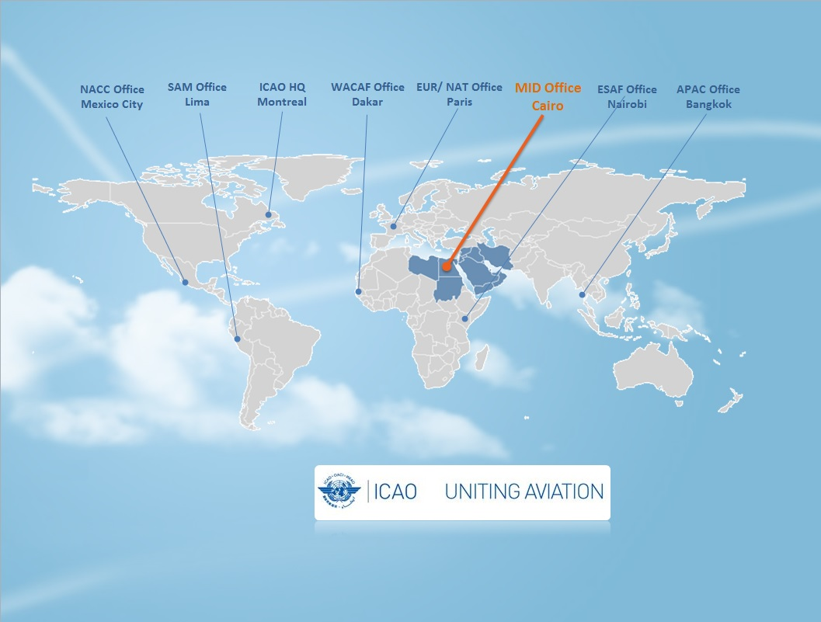
ขอขอบคุณ
شكرا
Thank You

